Slide 1
Digital Portfolio
STUDENT NAME: Rafia begam.y
REGISTER NO AND NMID: 222402628and asunm161222402628
DEPARTMENT: B.SC (ds)
COLLEGE: Prince shri Venkateswara arts and science college

Slide 2
Project title
Digital portfolio
The work of Rafia begam
The story of Rafia begam Creations

Slide 3
Agenda
Problem Statement
Project Overview
End Users
Tools and Technologies
Portfolio design and Layout
Features and Functionality
Results and Screenshots
Conclusion
Github Link

Slide 4

PROBLEM STATEMENT
1.Students and job seekers often rely only on resumes to showcase skills. Traditional resumes lack interactivity and creativity. Recruiters find it hard to assess true potential. A digital portfolio can bridge this gap effectively.

Slide 5

PROJECT Overview
Basic Portfolio This project is a simple personal website about me. It includes sections like About Me, Education, Hobbies, Skills, and Contact with my profile image. The goal is to give a neat introduction to my academic journey.

Slide 6

TOOLS AND TECHNIQUES
HTML → Used to build the basic webpage structure.
CSS → Used to make the page attractive with designs and styles.
Code Editor (VS Code) → To write and edit my code.
Browser (Chrome/Edge) → To check the output of my work.
GitHub Pages → To host my website and make it live online.

Slide 7
POTFOLIO DESIGN AND LAYOUT
Home → A welcome message with my name and profile image.
About Me → A short paragraph about myself.
Skills → A simple bullet or numbered list of my skills.
Education → Details in table format or plain text (School, College, Year).
Hobbies → A simple list of hobbies.
Contact → My phone number, email, and address in plain text.
Responsive → On mobile, everything stacks in a single column.
7

Slide 8
FEATURES AND FUNCTIONALITY
Easy navigation – smooth movement between sections. Profile picture – makes the page more personal. Project details – explains my works clearly. Responsive view – adapts to screen sizes. Simple design – keeps focus on main content.

Slide 9
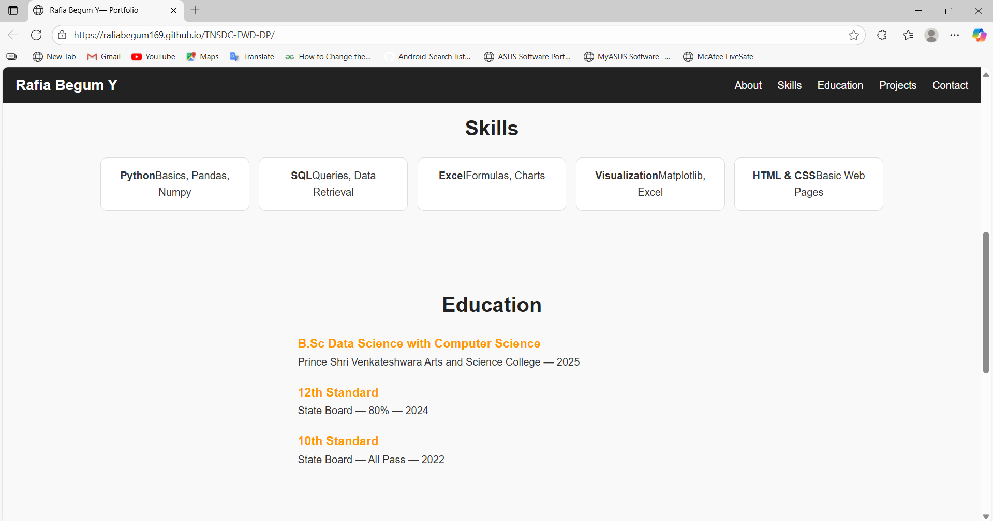
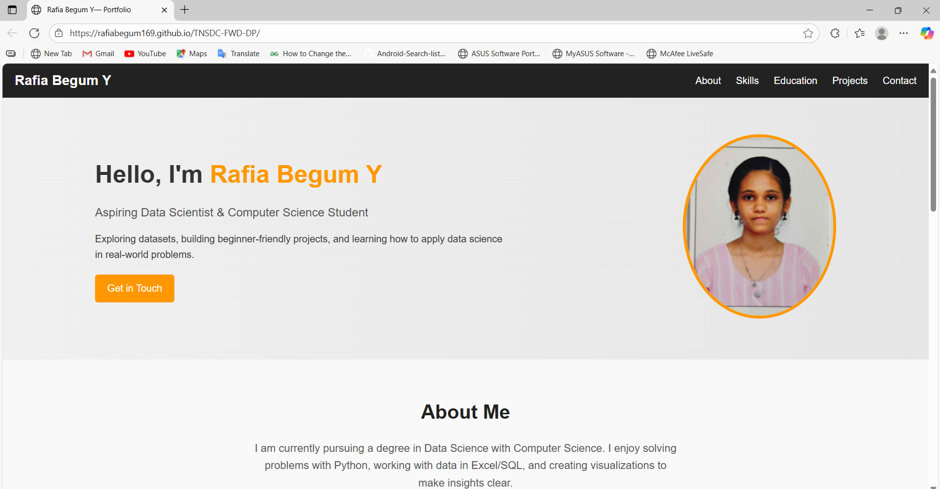

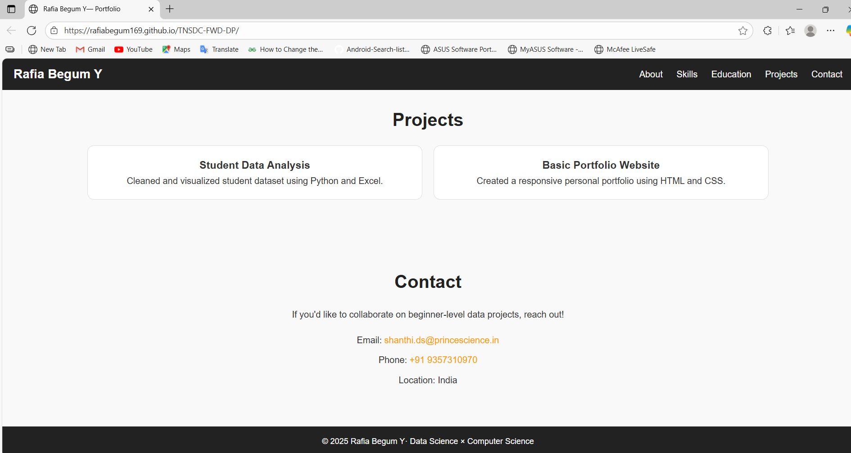
RESULTS AND SCREENSHOTS
Add your portfolio screenshot
3/21/2024 Annual Review
9

Slide 10
CONCLUSION
My portfolio is an online representation of me.It covers my About, Education, Skills, and Hobbies. The design is simple, clean, and readable. It can be accessed anytime through a browser.This project improved my basic web development knowledge.
GITHUB:
10

